Slide 1
Line 5 Ways

Slide 2
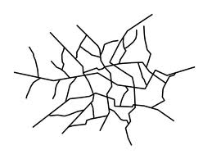
LINE
Line is the path of a point moving through space
The 5 types of lines are:

Slide 3
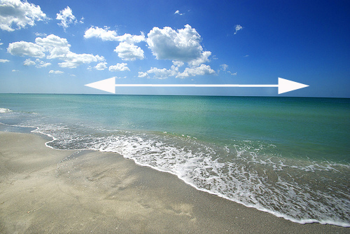
Horizontal Lines
Horizontal Lines are lines that run parallel to the ground.
These lines represent:
Peacefulness
Calm

Slide 4
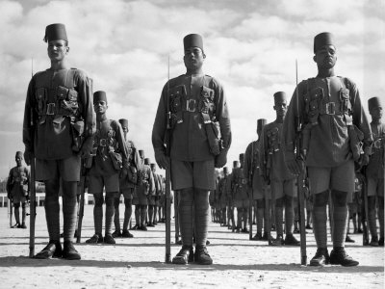
Vertical Lines
Vertical Lines are lines that run up and down.
These lines suggest:
Strength
Dignity
Formality

Slide 5
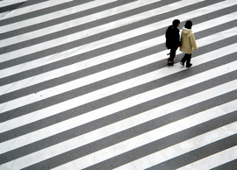
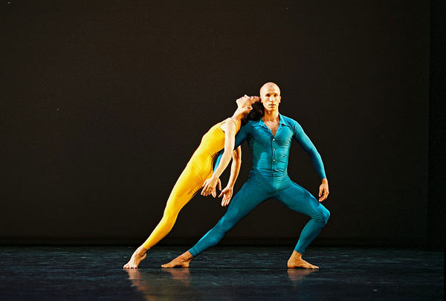
Diagonal Lines
Diagonal Lines, or Slanting Lines, run on an angle.
These lines suggest
Tension

Slide 6
Curved Lines
Curved lines: waves and spirals.
These lines suggest
Flowing Movement

Slide 7
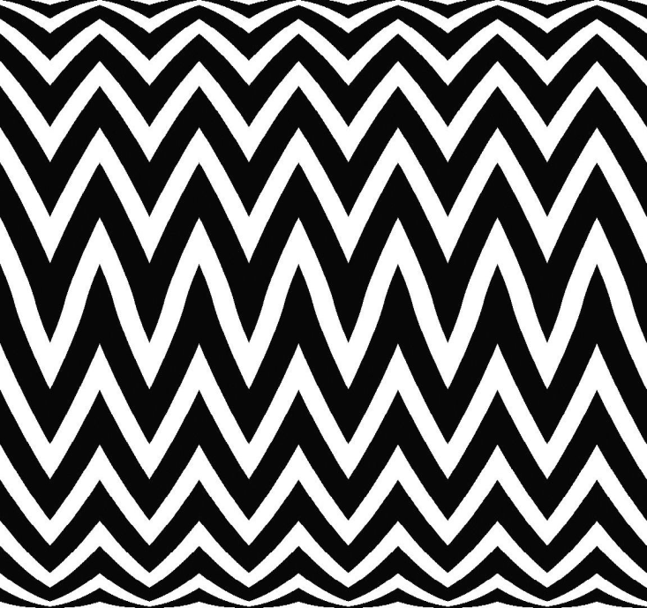
Zigzag Lines
Zigzag Lines move back and forth like a “Z”
These lines suggest
Confusion
Action

