Slide 1
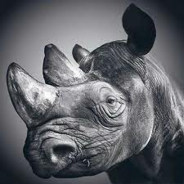
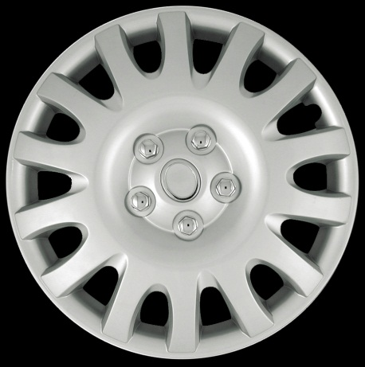
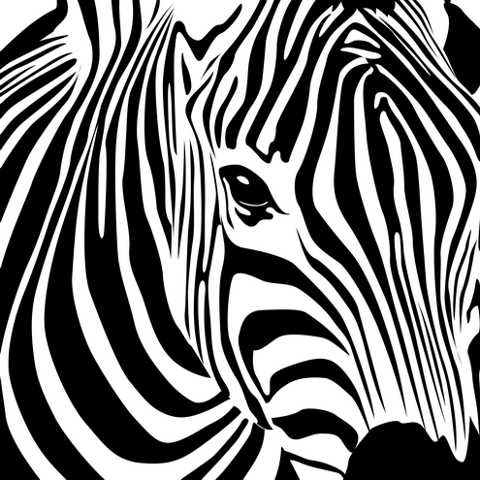
Principles of Design
How the Elements are Arranged

Slide 2
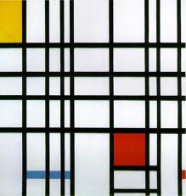
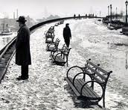
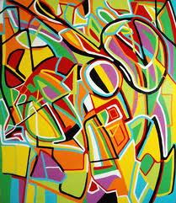
Art Composition
Composition: The organization or arrangement of a work of art
Composition includes:
Balance
Contrast
Emphasis
Movement
Pattern
Rhythm
Unity
Harmony

Slide 3
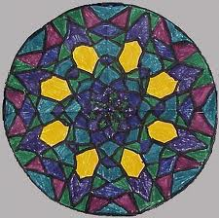
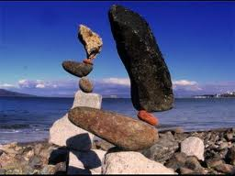
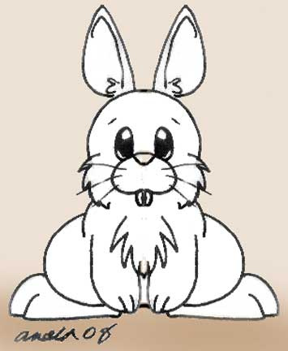
Balance:
Balance: An art and design principle concerned with the arrangement of one or more elements in a work of art so that they appear symmetrical (even) or asymmetrical (uneven) in design and proportion.

Slide 4
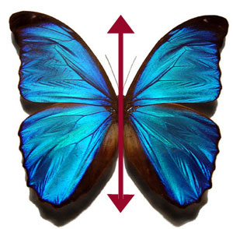
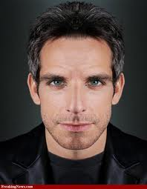
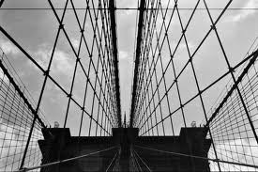
Formal Balance- Symmetrical
In symmetrical balance, the two halves “mirror” or closely resemble each other.

Slide 5
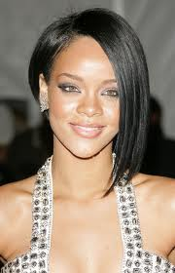
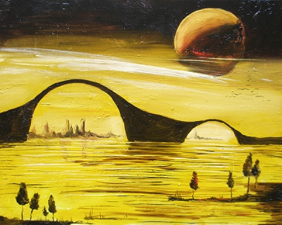
Informal Balance- Asymmetrical
In asymmetrical balance, different elements appear to have equal weight. For example, several smaller shapes in different hues at one side of a painting an balance a much larger shape on the other side.

Slide 6
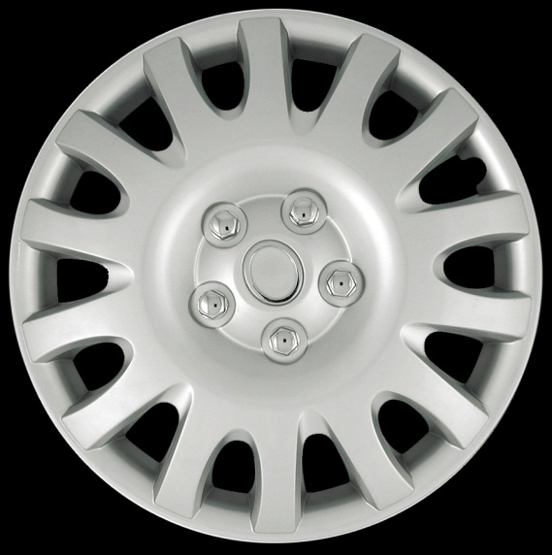
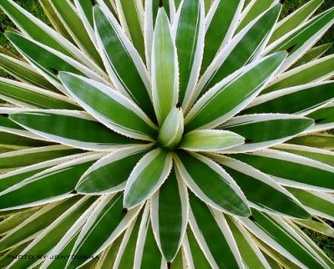
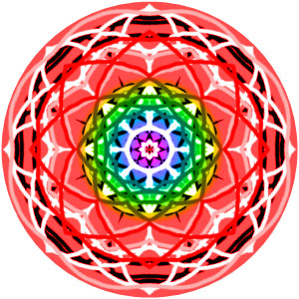
Radial Balance
Artworks with radial balance have elements or objects positioned around a central point or hub.

Slide 7
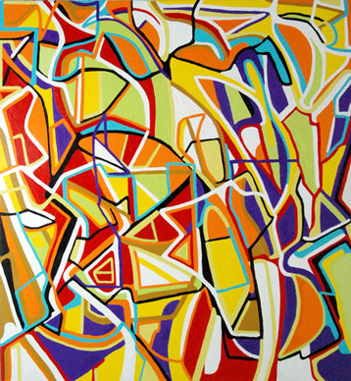
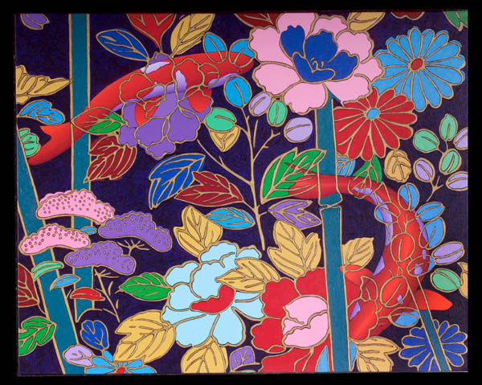
Variety
Variety is the principle of art concerned with combining art elements with slight changes to increase visual interest.

Slide 8
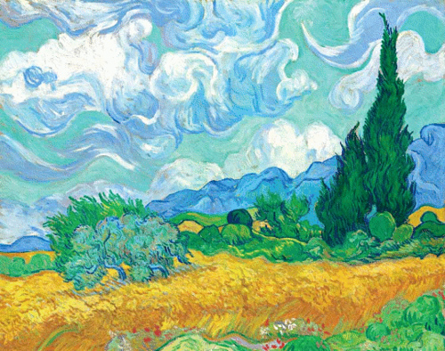
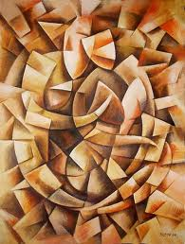
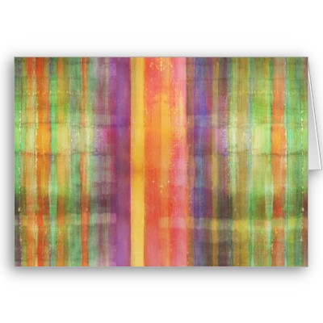
Harmony
Harmony is the principle of art concerned with combining similar art elements to create a pleasing appearance.

Slide 9
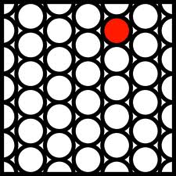
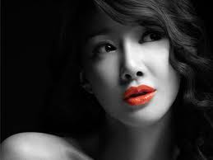
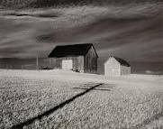
Emphasis:
Emphasis: Emphasis is the point of attraction in a piece of art that draws the viewers eye.

Slide 10
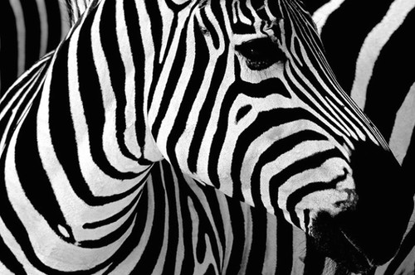
Contrast:
Contrast: The use of opposing elements, such as colors, forms, or lines, in proximity to produce an intensified effect in a work of art.

Slide 11
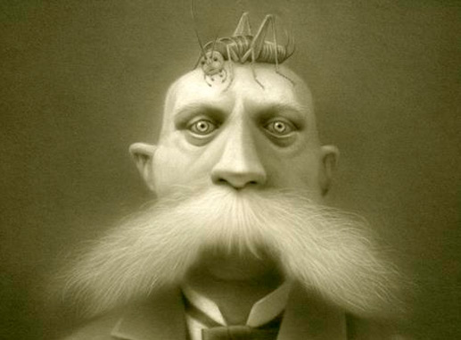
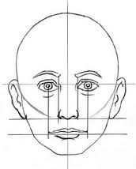
Proportion
Proportion is the principle of art concerned with the relationship of certain elements to the whole and to each other.

Slide 12
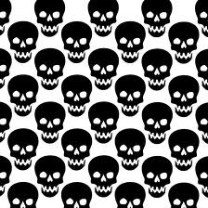
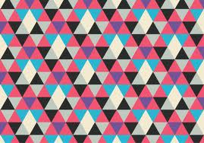
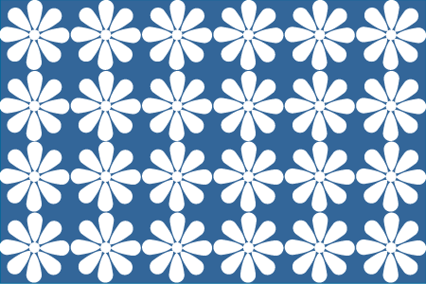
Pattern
In art, a pattern refers to a two dimensional decorative effect achieved through the repetition of colors, lines, shapes, and/or textures.

Slide 13
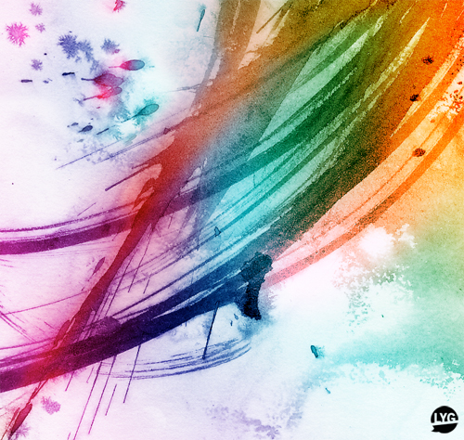
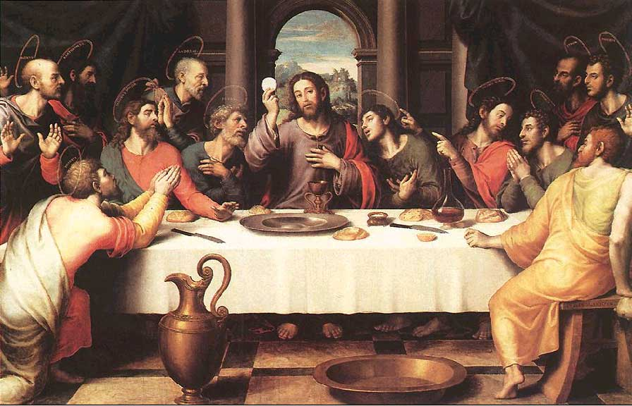
Movement
Artists often use Movement to lead the viewer’s eye from one part of an artwork to another. Movement is the principle of art concerned with creating the look and feeling of action to guide a viewer’s eye throughout a work of art.

Slide 14
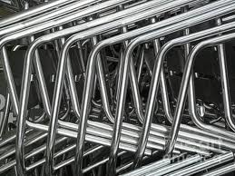
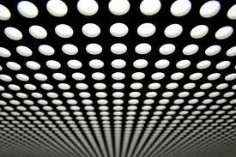
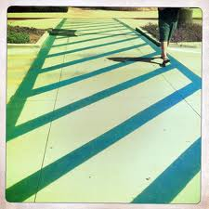
Rhythm/Repetition:
Rhythm is created to make artwork seem active. Rhythm is the principle of art concerned with repeating an element of art to make a work seem active or to suggest vibration.

Slide 15
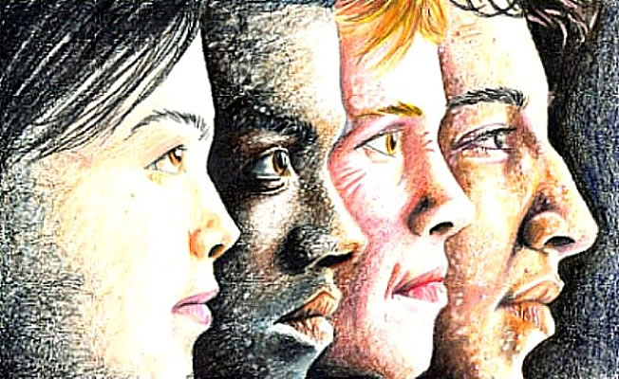
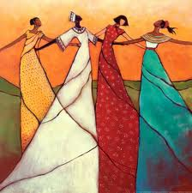
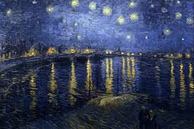
Unity
When the elements and principles in a work of art are skillfully combined, the work has a “wholeness” to it. The term unity is defined as a look and feel of oneness or completeness in a work of art

