Slide 1
The Elements of Art

Slide 2
The Elements of Art
Line
Color
Shape
Space
Form
Texture

Slide 3
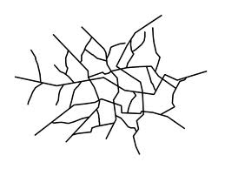
LINE
Line is the path of a point moving through space
The 5 types of lines are:

Slide 4
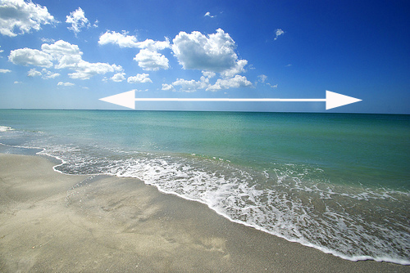
Horizontal Lines
Horizontal Lines are lines that run parallel to the ground.
These lines represent:
Peacefulness
Calm

Slide 5
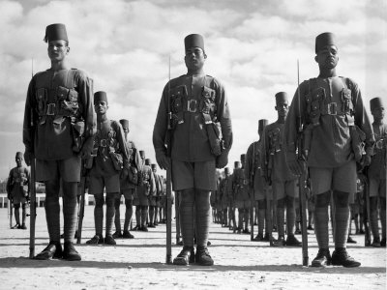
Vertical Lines
Vertical Lines are lines that run up and down.
These lines suggest:
Strength
Dignity
Formality

Slide 6
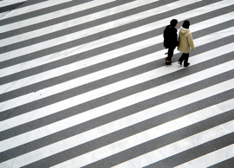
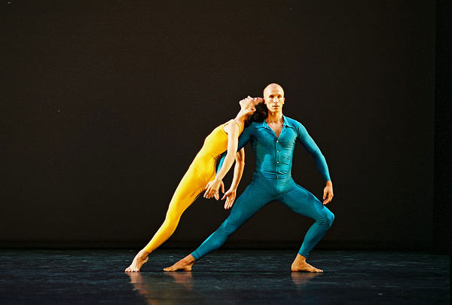
Diagonal Lines
Diagonal Lines, or Slanting Lines, run on an angle.
These lines suggest
Tension

Slide 7
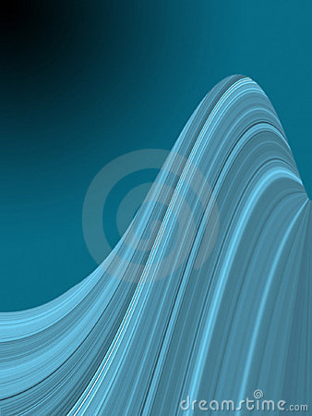
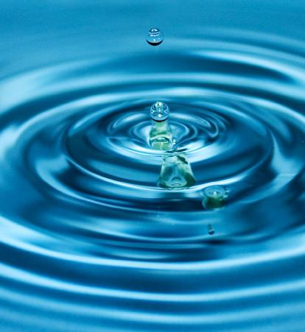
Curved Lines
Curved lines: waves and spirals.
These lines suggest
Flowing Movement

Slide 8
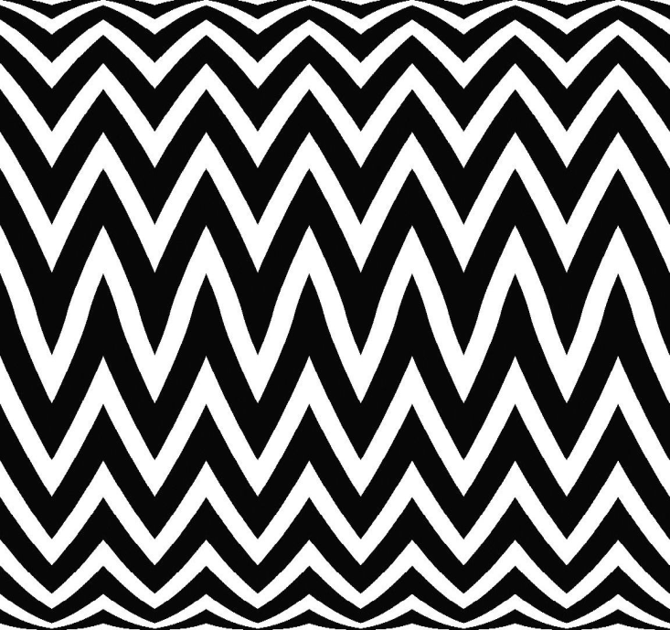
Zigzag Lines
Zigzag Lines move back and forth like a “Z”
These lines suggest
Confusion
Action

Slide 9
COLOR
COLOR is what your eye sees when LIGHT is reflected off of an object
Colors have three distinctive properties:
Hue
Value
Intensity

Slide 10
Hue
Hue refers to the NAME of color.
Red is a Hue
So are Blue and Yellow

Slide 11
Value
Value refers to the LIGHTNESS or DARKNESS of a hue

Slide 12
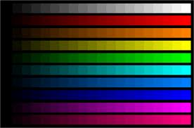
Intensity
Intensity refers to the BRIGHTNESS or DULLNESS of a hue- dependant on light.
When a hue is strong and bright, it is said to be HIGH in intensity. When that same hue is faint and dull, it is said to be LOW in intensity

Slide 13
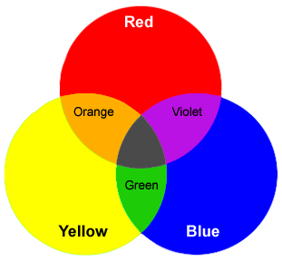
The Color Wheel

Slide 14
Primary and Secondary
Primary
Blue
Yellow
Red
Secondary
Orange
Green
Purple

Slide 15
Shape
Shape refers to an area clearly set off by one or more of the other elements.
Shape has TWO- Dimensions
Height
Width
There are TWO types of shapes

Slide 16
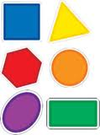
Geometric Shapes
Geometric Shapes look as though they were made with a ruler or a drawing TOOL

Slide 17
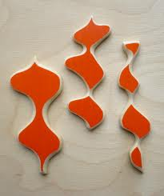
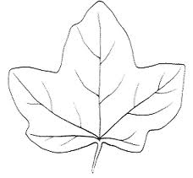
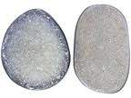
Organic Shapes
Organic or Free-form shapes can be curved, angular, or a combination of both.
These shapes are often found in nature.

Slide 18
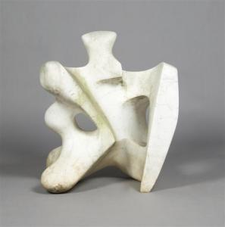
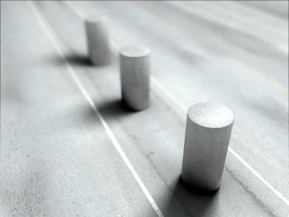
Form
Form is an object with THREE-Dimensions
These dimensions are
Height
Width and
DEPTH
These forms exist in real space and can be touched.

Slide 19
Space
Space refers to the DISTANCE between, around, above, below, and within shapes.
In both Two and Three-Dimensional works of art, the shapes and forms are called POSITIVE SPACES.
The empty areas around and in between these shapes are called NEGATIVE SPACES.

Slide 20
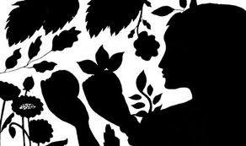
Positive and Negative Spaces

Slide 21
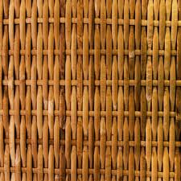
Texture
Texture is the element that refers to the way things feel, or look as though they might feel if TOUCHED.
Some types of textures are:

